Slide 1

Grad-CAM: Visual Explanations from Deep Networks via Gradient-based Localization
3 Feb 2020
Presenter: Sanchit Sinha
https://qdata.github.io/deep2Read/

Slide 2
Motivation
Answer these questions:
Why do neural networks predict the way they do?
Why do NNs make predictions which seem to be totally irrelevant
What parts of an image are the most useful in predictions
Does adversarial perturbation of image change where the NN “look”?
Generalize an explainability method which works across all types and varieties of CNNs
Should also work on different domains - classification, segmentation, VQA, etc.
Notes:
The motivation of this project

Slide 3
Background
Explainability and performance are often a tradeoff
Simple rule based classifiers with very high explainability do not perform well on complex tasks
Complex DNNs are often considered “black boxes” but are very good at complex tasks (sometimes better than humans)
GradCAM builts with inspiration from Class Activation Mapping which was proposed to find the “active” regions in pure CNNs
Guided Backprop was the first such technique to venture into explainability - it gives high quality pixel-space gradient visualization methods.
Deconvolution is also similar to Guided Backprop

Slide 4
Related Work
Guided Backprop
Deconvolutions
CAM
VQA
Localization/Segmentation

Slide 5
Claim / Target Task
Class-discriminative localization technique that generates visual explanations for any CNN-based network
Apply Grad-CAM to existing top-performing classification, captioning and VQA models.
Proof-of-concept of how interpretable GradCAM visualizations help in diagnosing failure modes
Present Grad-CAM visualizations for ResNets
Neuron importance from Grad-CAM and neuron names
Notes:
Here, we make the claim of this project.

Slide 6
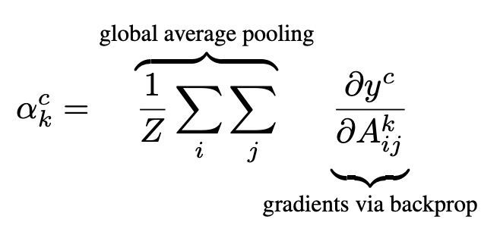
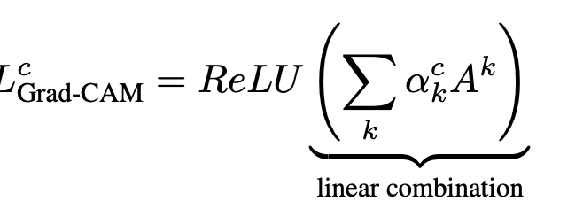
Proposed Solution
First taking derivatives with respect to the output (before the softmax) of a particular class.
Global average pooling over the width*height of the desired map. Obtaining map level importance score.
As we are only interested in the activations which give “positive” influence on the scores, we have to remove the negative gradients. So we apply the ReLU operation.
Notes:
Here is our proposed solution.

Slide 7
Implementation
Only used the Convolution layer output from the last convolution layer before the fully connected layers.
Why? - The last layer will have the largest receptive field and will give the best spatial information.
Why only Conv layers? - If we use it in FC layers, the spatial information is lost
Guided GradCAM - Hadamard product (element-wise) of the heatmaps from the GradCAM and Guided Backpropagation.
Why? - Guided Backprop gives much higher quality output. Taking element-wise product with the GradCAM output will definitely only highlight the most important and high quality areas of the maps
Notes:
In the rest of this presentation, I’m going to talk about following contents:

Slide 8
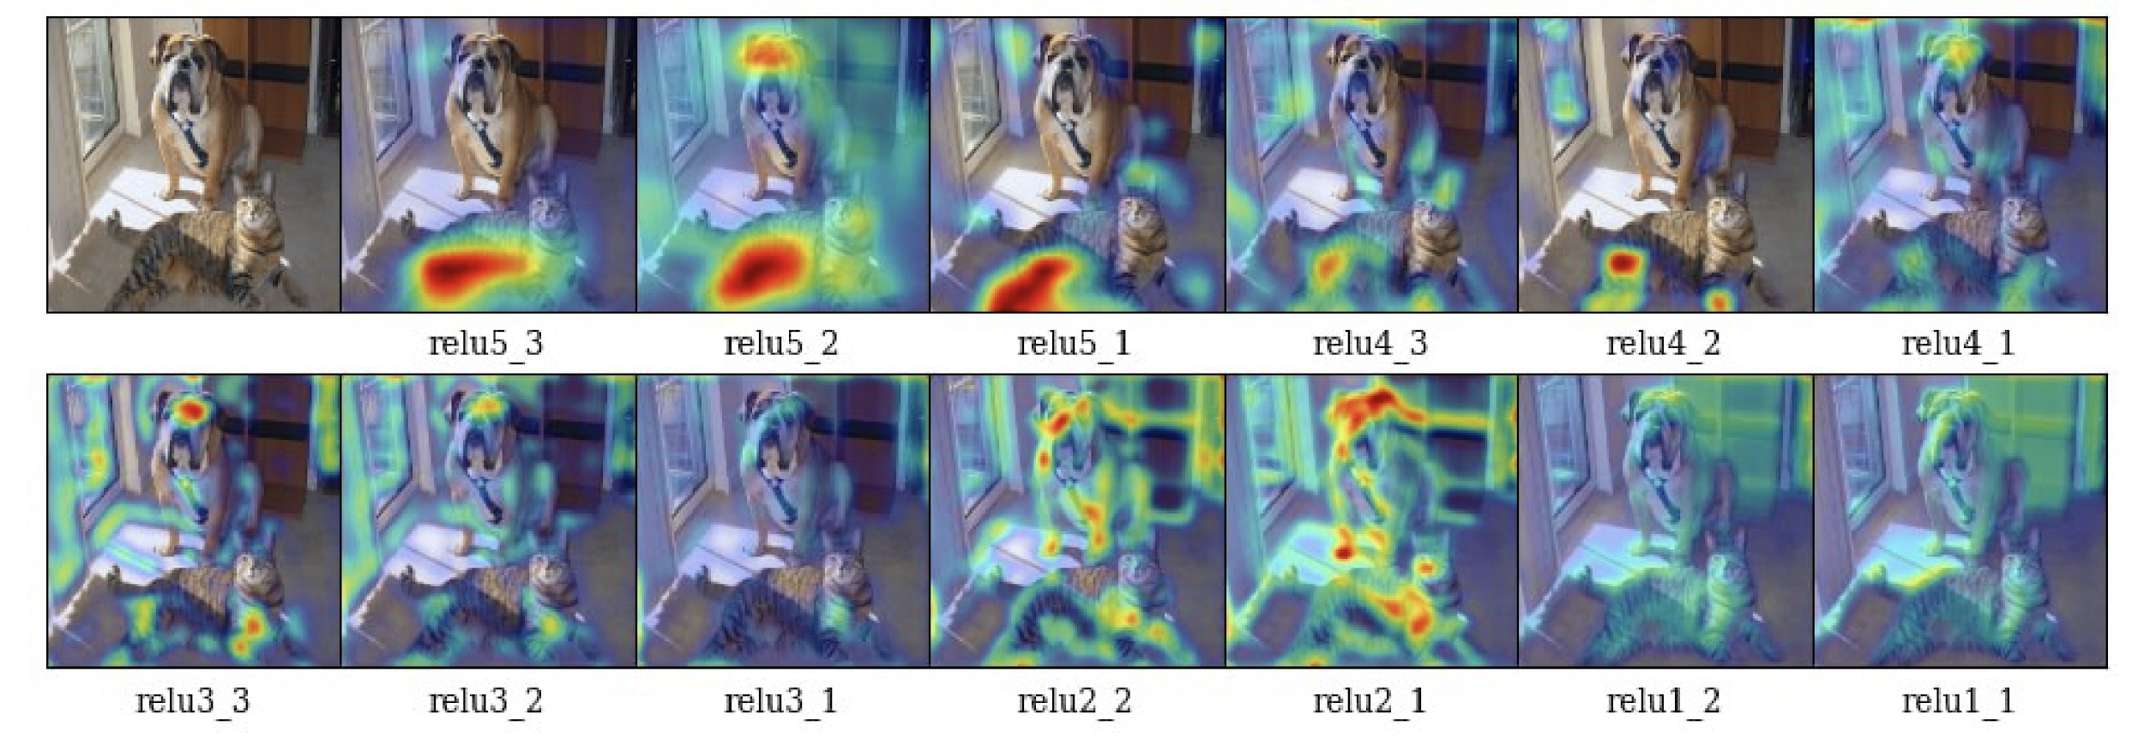

Slide 9
Data Summary
Too many different to summarize.
Imagenet
Pascal VOC
COCO
Notes:
In the rest of this presentation, I’m going to talk about following contents:

Slide 10
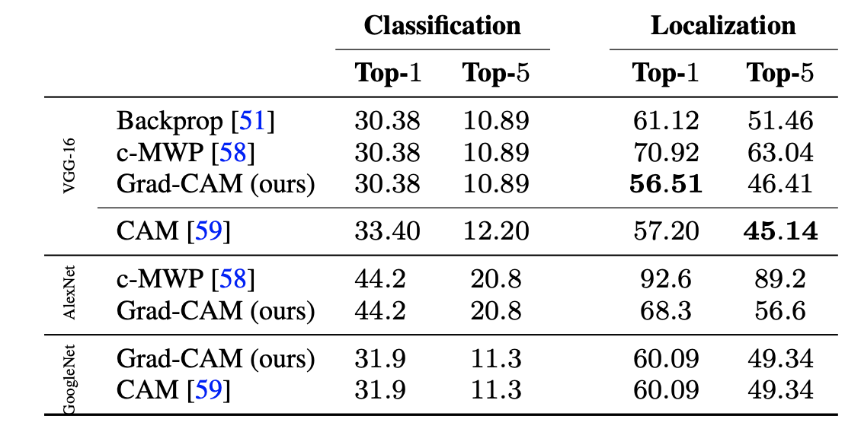
Experimental Results - Localization
Notes:
In the rest of this presentation, I’m going to talk about following contents:

Slide 11
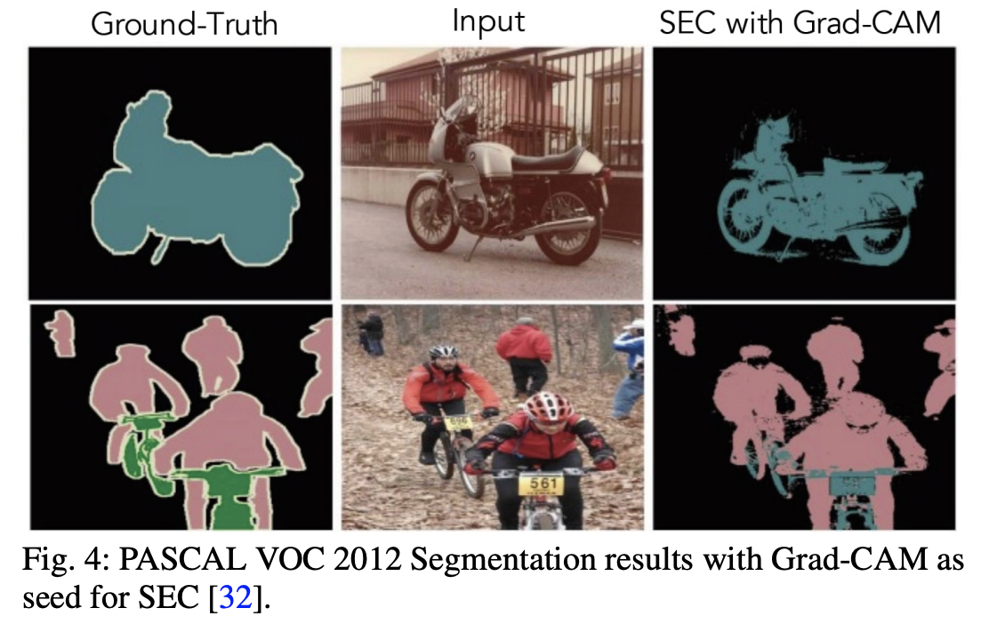
Experimental Results - Segmentation
Notes:
In the rest of this presentation, I’m going to talk about following contents:

Slide 12
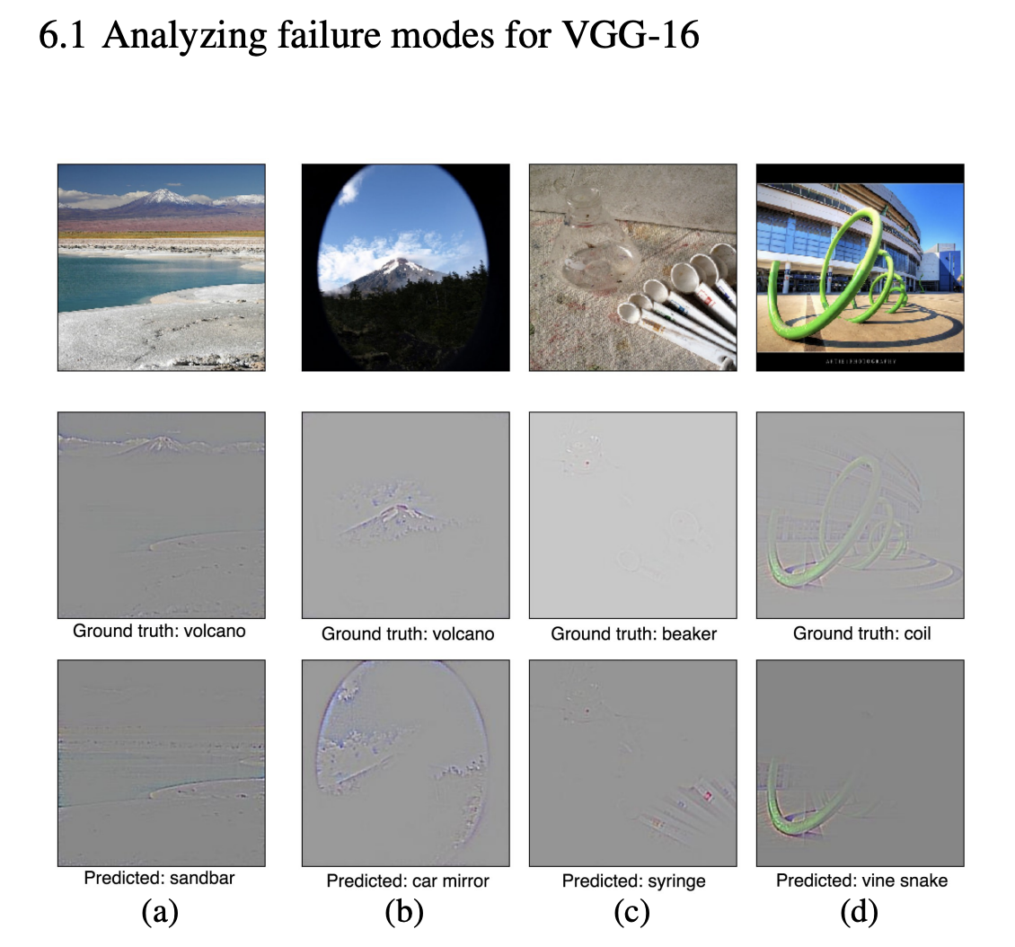
Experimental Results - Diagnosis
Notes:
In the rest of this presentation, I’m going to talk about following contents:

Slide 13
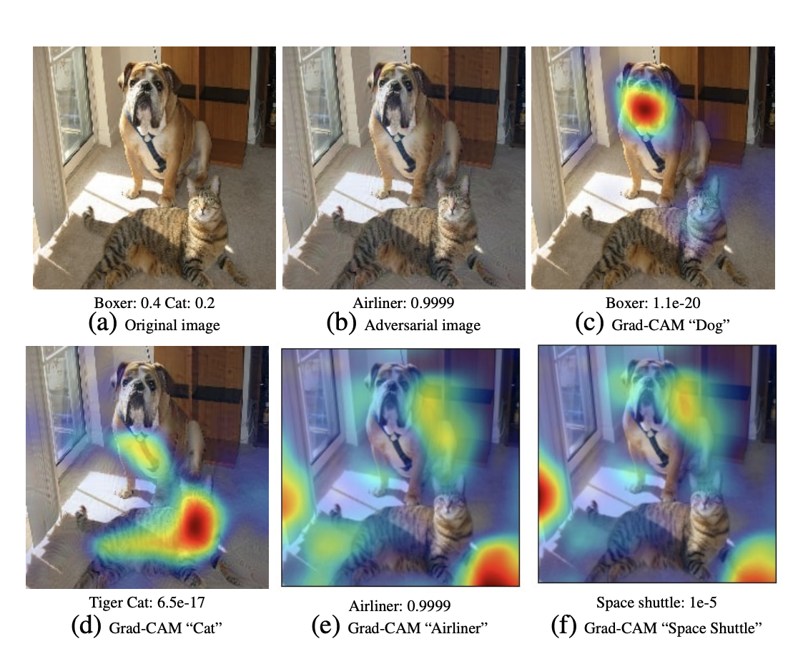
Experimental Results - Adversarial
Notes:
In the rest of this presentation, I’m going to talk about following contents:

Slide 14
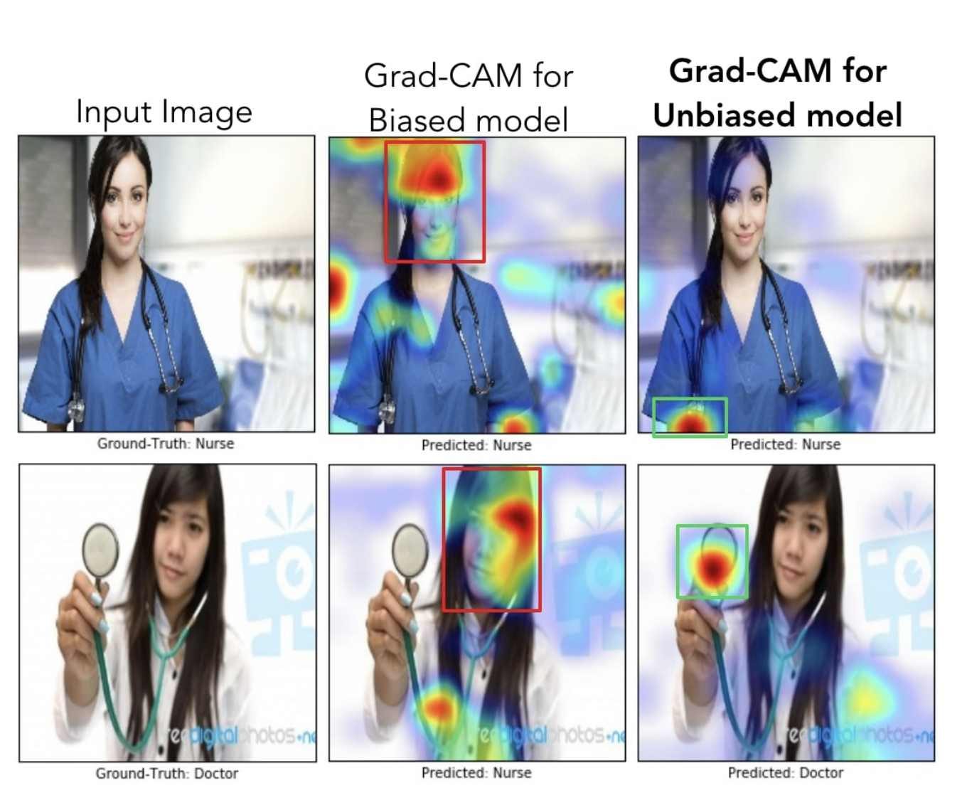
Experimental Results - Bias
Notes:
In the rest of this presentation, I’m going to talk about following contents:

Slide 15
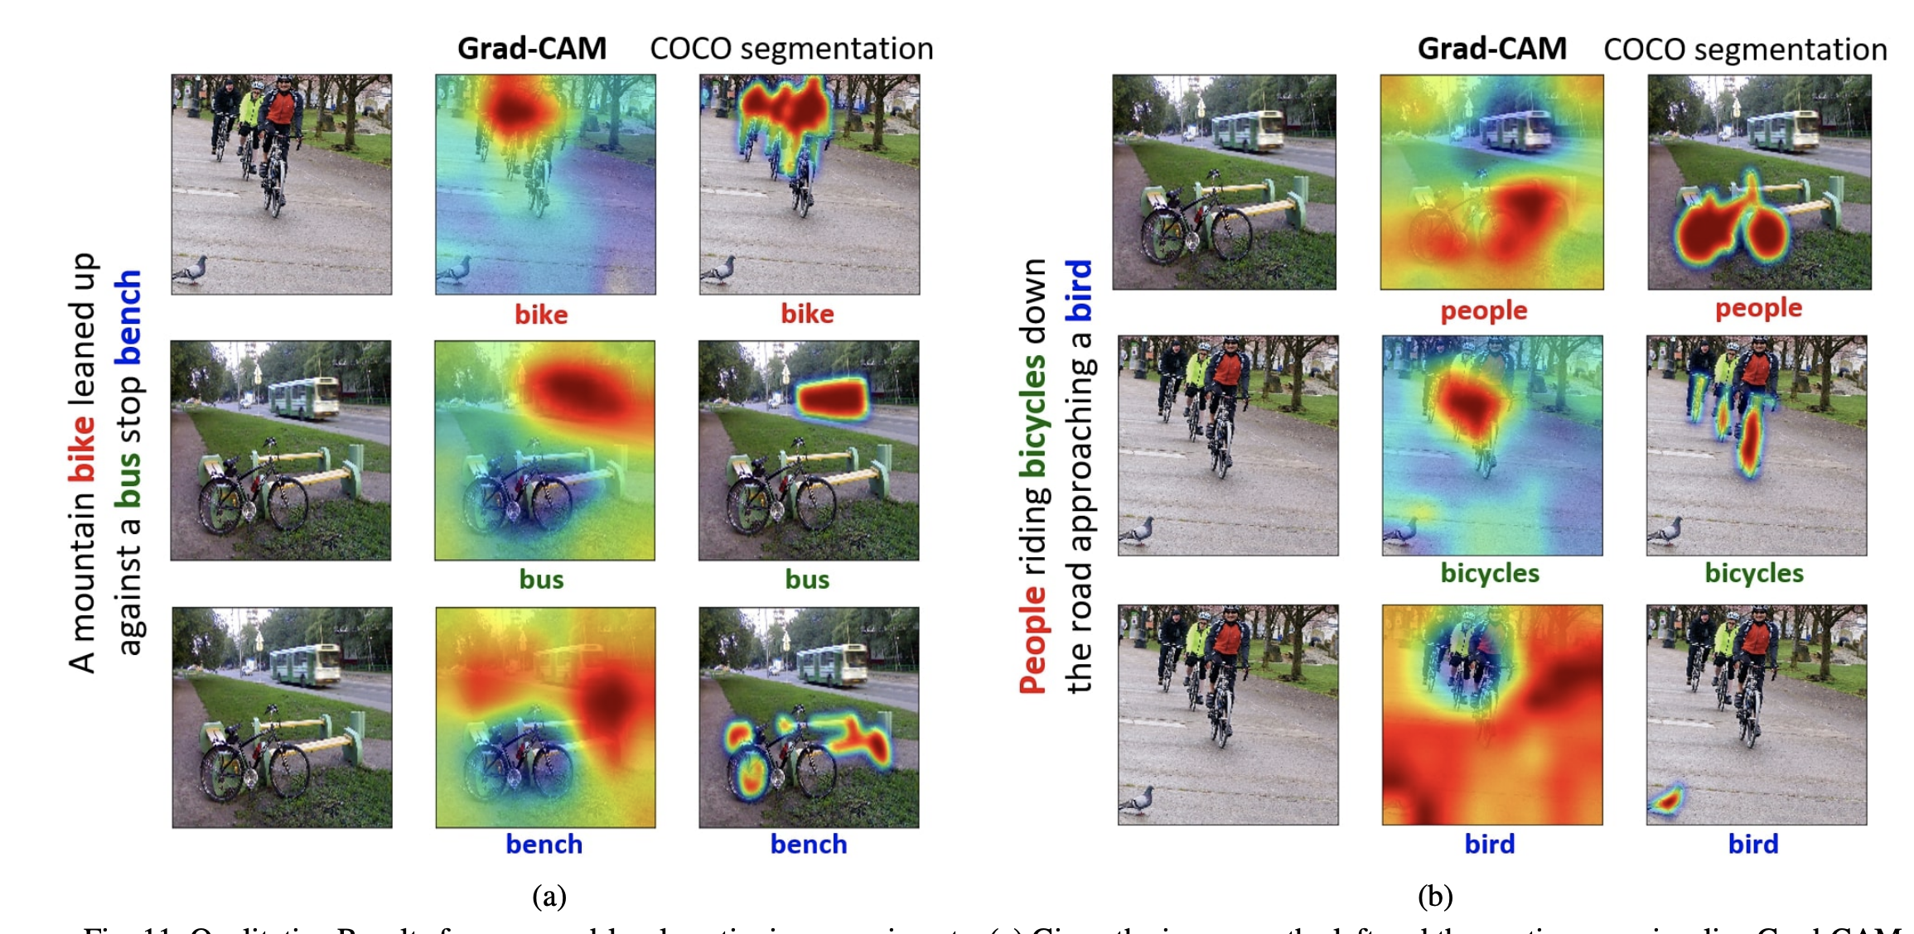
Experimental Results - Captioning
Notes:
In the rest of this presentation, I’m going to talk about following contents:

Slide 16
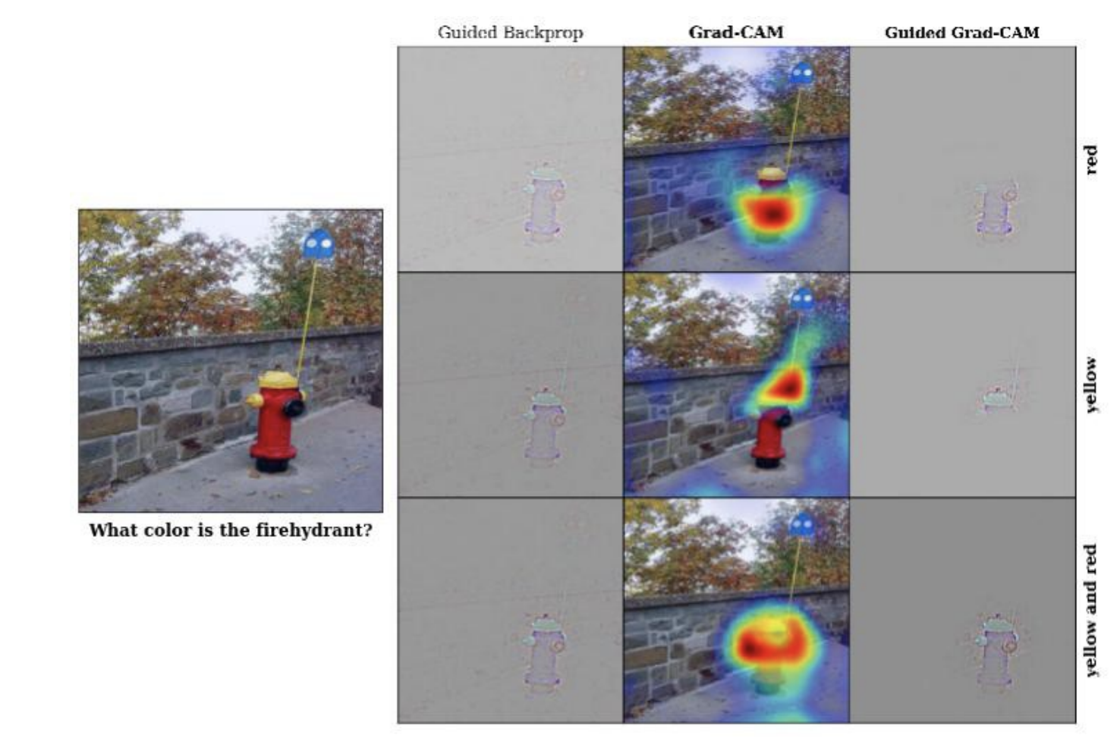
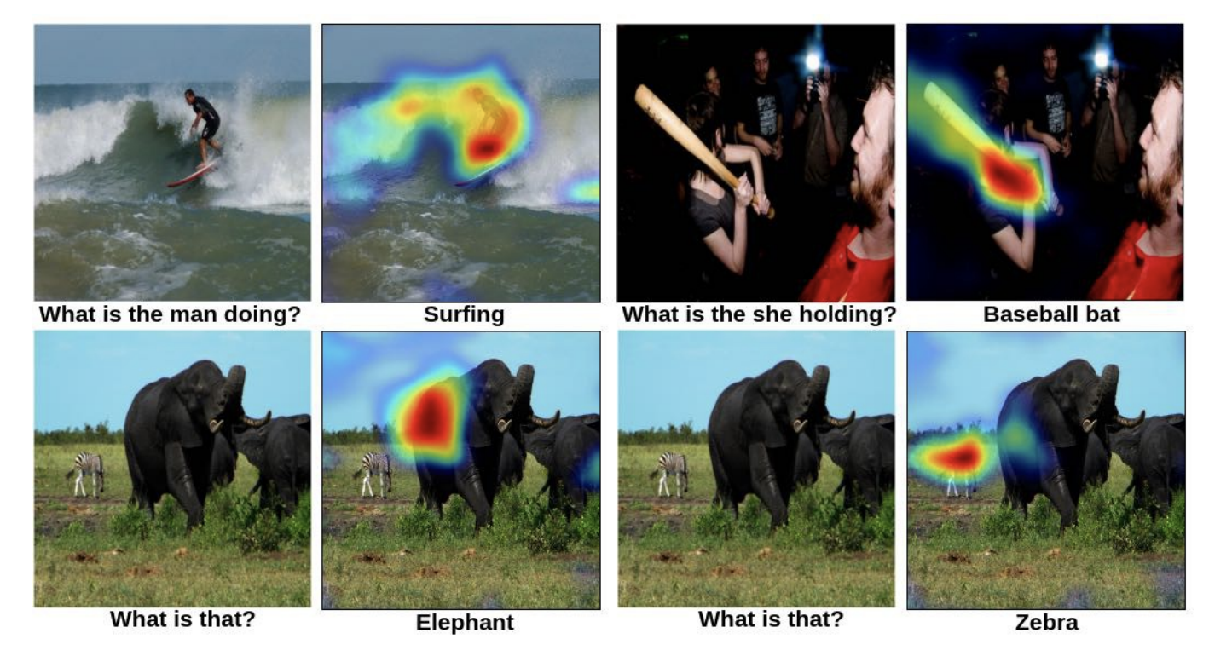
Experimental Results - VQA
Notes:
In the rest of this presentation, I’m going to talk about following contents:

Slide 17
References
D. Erhan, Y. Bengio, A. Courville, and P. Vincent. Visualizing Higher-layer Features of a Deep Network. University of Montreal, 1341, 2009. 3 17.
M. Everingham, L. Van Gool, C. K. I. Williams, J. Winn, and A. Zisserman. The PASCAL Visual Object Classes Challenge 2007 (VOC2007) Results.
M. Oquab, L. Bottou, I. Laptev, and J. Sivic. Is object localization for free? – weakly-supervised learning with convolutional neural networks. In CVPR, 2015.

